Slide 1
Monopoly
Problems and solutions to Monoply

Slide 2
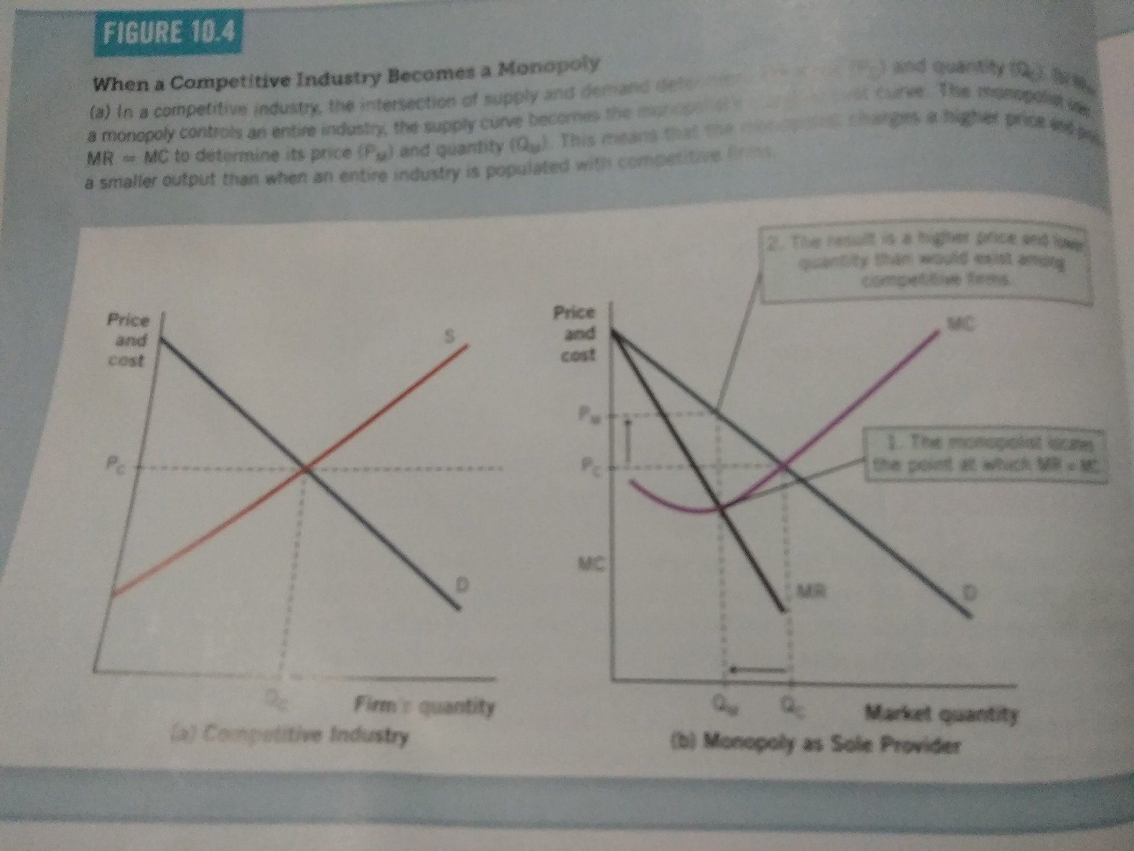
Problems with monopoly
Inefficient output and price
Monopolist charges too much and produces too little.
Panel A: Each firm is a Price taker
Panel B: pricing and output decision for monopoly
MR = MC
Output Q = (Qm<Qc)
Price P = (Pm>PC)
Competitve price P=MC
Monopolist charges a price P > MC

Slide 3
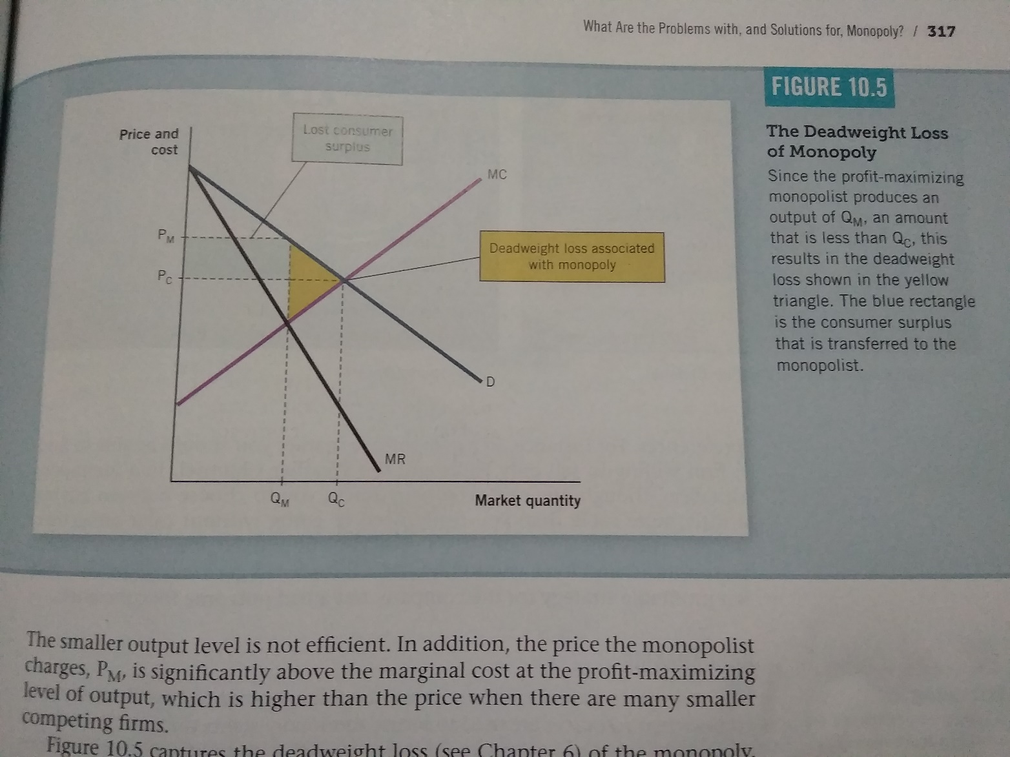
Deadweight loss of monopoly
The monopolist charges too high a price and produces too little of the product , so some consumers who would benefit from a competitive market lose out.
Society would be better off if the output is expanded to Qc.
Consumer surplus is transferred to monopolist, as shown in the blue triangle.

Slide 4
Problems with monopoly
Few choices to consumers
Eg. Cable TV Operators
Rent Seeking
Occurs when resources are used to secure monopoly rights through political process.
Indian Steel Industry

Slide 5
Solutions to the Problems of Monopoly
Breaking up the monopolist (AT &T)
Reducing Trade barriers
Regulating markets
Do nothing
Firms with profit motive have an incentive to minimize the costs of production. Lower costs translate into higher profits. If a manager do a poor job they will be fired.
The same cannot be said about government managers or bureaucrats.
There are fewer incentives to keep costs in check.
Public policy can mitigate the power of monopolies.

Slide 6
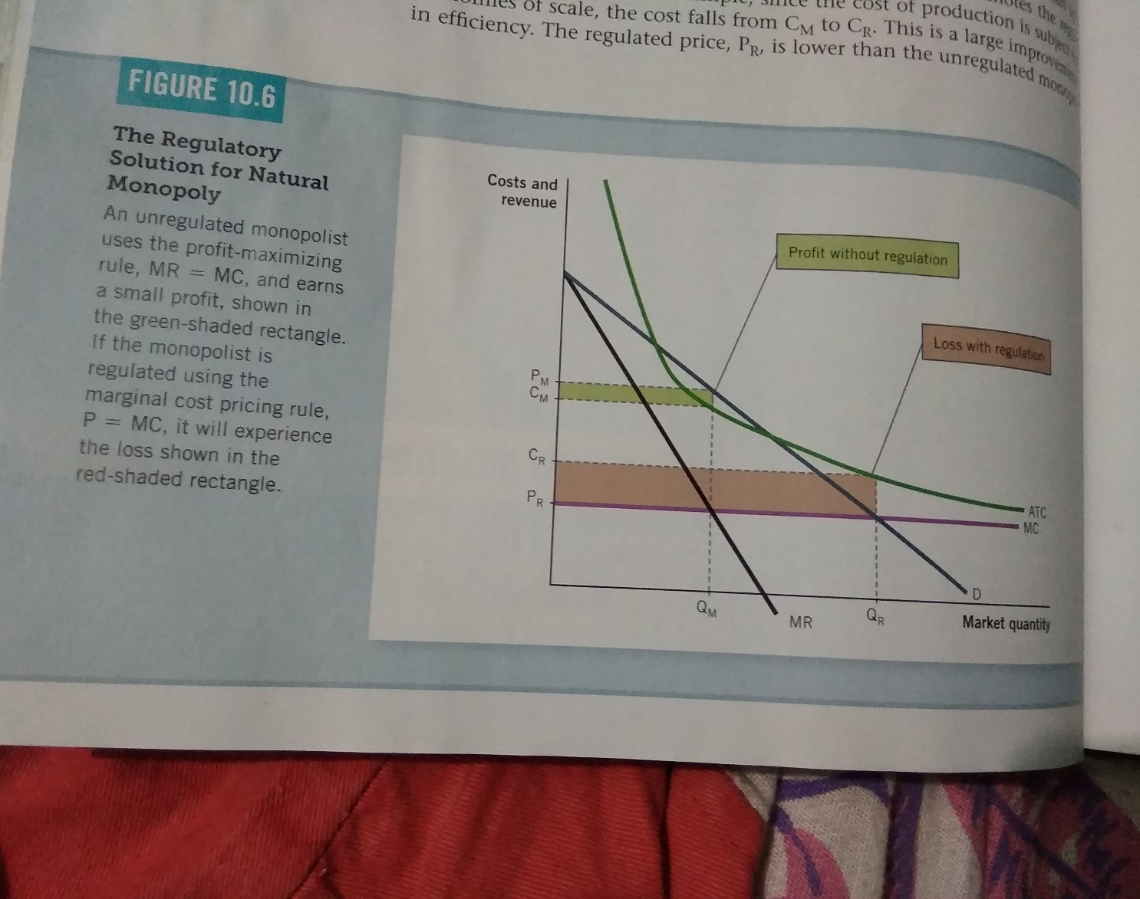
Regulating Markets
Natural Monopoly –Breaking up would result in higher production costs.
Keeping monopoly would be best option
In this situation, policy makers might attempt to create a more efficient outcome and maximize the welfare of society by regulating the monopolist’s prices.
Marginal cost pricing rule P = MC
Unregulated monopolists sets MC =MR and produces Qm at the Price Pm. Pm is greater than average cost or Cm. Monopolists earns profit green box.
If the firm is regulated P= MC Output expands to Qr and Price is Pr. Firm makes loss given as red box.
Three options: make up for loss and subsidize the monopolists
Set the Price P = ATC break even (Noprofit or no loss)
Government could own and operate the business in lieu of private firm.

